Slide 1
Ancient Diseases
Emrah Kırdök

Slide 2
Ancient Diseases
Disease oriented microbiome
Pathogens
Notes:
Before ancient diseases, I would like to express how I look on “disease”. Generally particular pathogens are responsible for disease cases. However recent studies on human microbiome showed that, diseases could arouse from a disease oriented microbiome state as well.
There are documented cases showing that a disease oriented microbial state could cause different kind of diseases:
Autoimmune diseases
Autism

Slide 3
Healthy Microbiome
Absence of any overt disease (Lloyd-Price et al, 2016)
Immune system and microbiome work cooperatively
Notes:
We are contaminated with trillions of microbes. But most important, we are co-evolved with them. Every body part has its own microbial content and in a normal state, those microbes works cooperatively with our immune system to keep our bodies well functioned.
Microbes train our immune system.
Unfortunately there is no good consensus on what is a healthy microbiome.

Slide 4
Dysbiois
Departure from the healthy balance
Opportunistic pathogens finds a chance to propagate
Notes:
Dysbiosis is any change to the composition of resident commensal communities found in healthy microbiomes. It could be generally characterised as (Petersen and Round et al., 2014):
loss of beneficial microorganisms
expansion of potentially harmful microbes
loss of overall microbial diversity (think about alpha diversity)
Disease oriented microbiome creates a suitable environment for pathogenic microbes.
Rich metagenomics content believed to be “good”.

Slide 5
Ancient Diseases
Do we have a disease oriented microbiome?
Do we have a particular pathogen?
Notes:
So, there could be two questions. First question will be what type of microbiome we will observe from an ancient microbiome study? Will it be a disease oriented microbiome or ancestral state of the microbiome? And the second question will be could we observe a particular pathogenic microbe?
To answer the first question we need a sample type that could conserve the ancestral microbe over long periods of time. Luckily we have some sample types that have this ability:
dental calculus
mummified tissues
chewed mastic particles
For the second question we need a sampling strategy for a specific microbe. For example, it is shown that dental pulps have a richer microbial species content then other parts of the body
Also dental pulp could conserve blood borne pathogens.
But there are documented cases that other type of materials also conserve some pathogens (long bones). Especially if there are visible lesions.

Slide 6
Sample
DNA
Metagenomics
Microbial Diversity
Microbial Abundances
Pathogen Genomics
Notes:
The type of the historical material defines how we could move.
Add distances Pathogen genomics

Slide 7
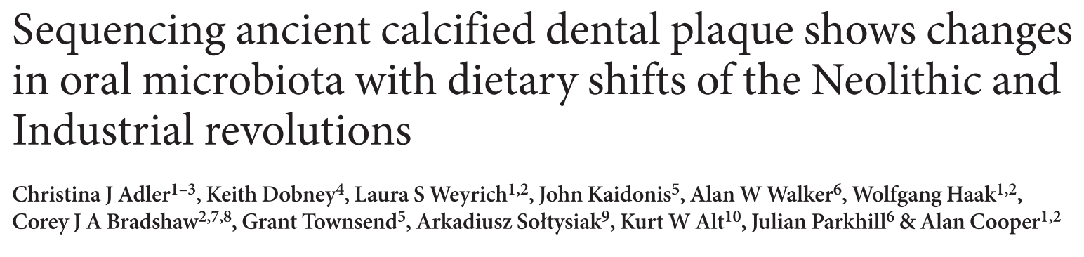
Notes:
Ancient calculus is one of the useful samples to study ancestral microbiome state. Oral microbiome is important since it is first entry point of our bodies. Changes in our diet, our lifestyle immediately affects oral microbiome.
This study uses amplicon sequencing strategy. They amplified 16S regions that targets bacterial pathogens.

Slide 8
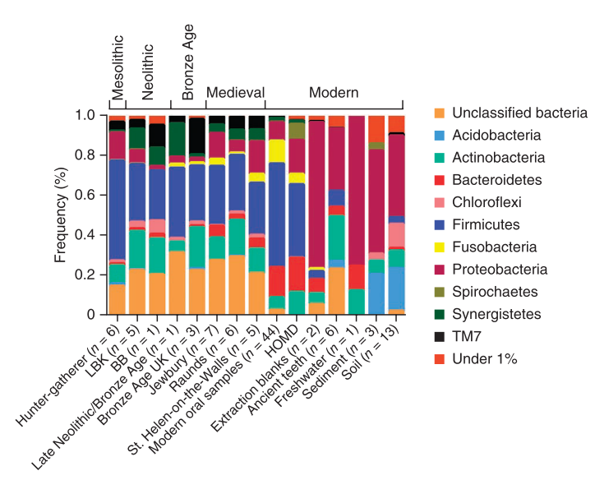
Phylum composition in the samples
Notes:
It is a good idea to compare ancient microbial composition with reference microbiome studies. In here they use Human Oral Microbiome Database to see if they catched the essence of oral microbiome.
Phylum composition shows good similarity to modern oral microbiome studies. In a healthy oral microbiome, Firmicutes, Fusobacteria and Acidobacteria phyla dominates.
That result shows that ancient calculus could conserve oral microbiome over a long periods of time.

Slide 9
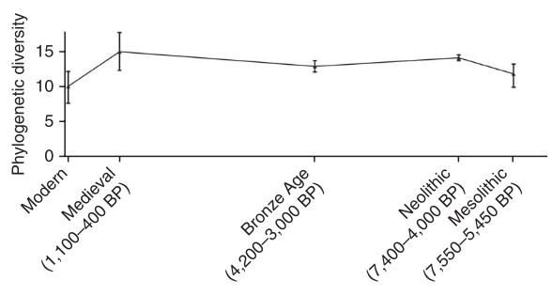
Changes in diet makes a loss in the genetic diversity
Notes:
However phylum composition is not the only thing that we should focus. As we talked in the first part of the lecture, species richness plays an in important role. Loss of species diversity is a sign of dysbiosis.
In this figure, they calculated the phylogenetic diversity using V3 sequences.
This figure shows that there is a loss of diversity in modern oral microbiomes. That means a disease associated configuration. So authors concluded that modern oral microbiome could have a more disease-oriented state.

Slide 10
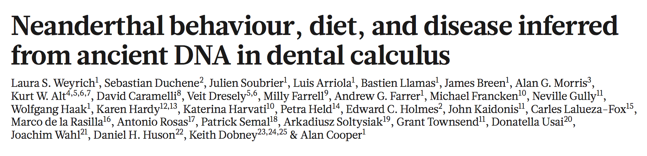
Notes:
This is another calculus study. The authors sought how diet affects the overall oral microbiota. Authors have used both amplicon and shotgun sequencing strategies.
Spy cave: A meat based diet observed in Neandertals in Belgium Spy cave
El Sidron: No meat was detected in El Sidron, Spain

Slide 11
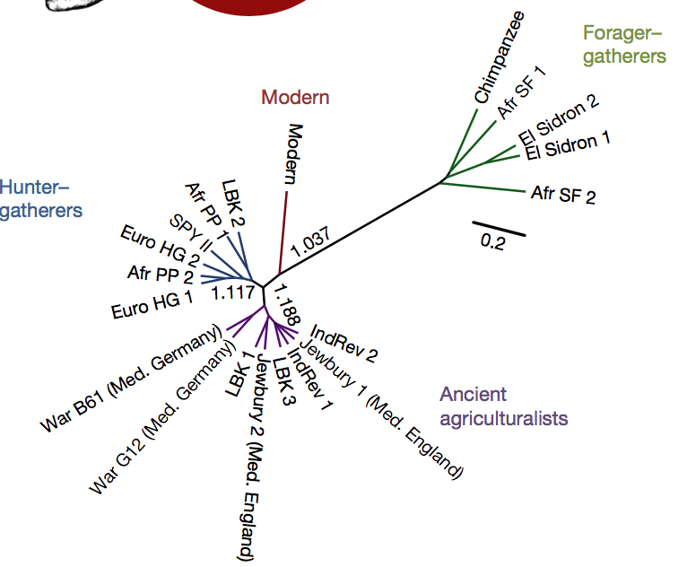
UPGMA clustering of Bray-Curtis distances of microbial compositions
Notes:
This slide shows how diet effects the oral microbiome. El Sidron individuals clustered with forager-gatherer populations. While SPY Neanderthal profile is closer to hunter gatherer population.
So, meat based diet changes the overall oral microbiome content.

Slide 12
Pathogen genomes:
Methanobrevibacter oralis
Red complex
Species that are responsible for periodontitis
Notes:
M. oralis is an archaea commensal microbe and it is one of the oldest ancient genomes reconstructed. The ancient stain contains some biofilm producing genes.
Red complex: Species that are involved in periodontitis

Slide 13
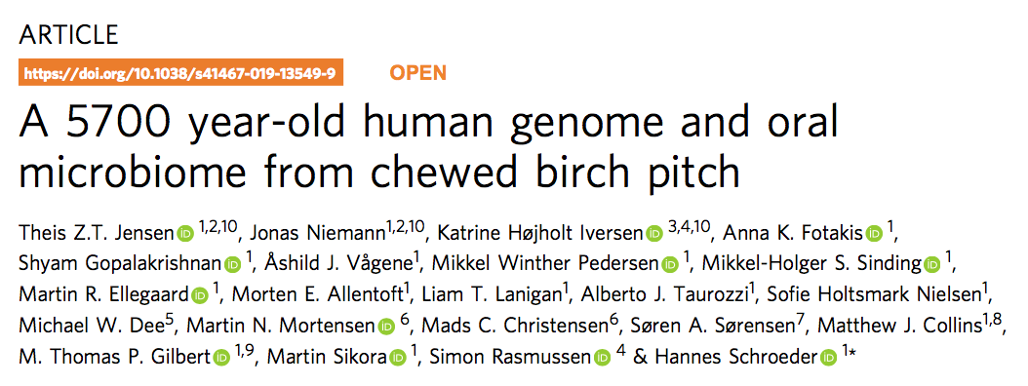
Notes:
Chewed mastic particles are one of the other sources of ancestral microbiome.
In ancient times people chewed those particles to make tools, or fix broken things as a adhesive matrix. So they could contain notable amounts of oral micribome species.
A study shows that chewing gums encapsulate at least 20% of the oral species.

Slide 14
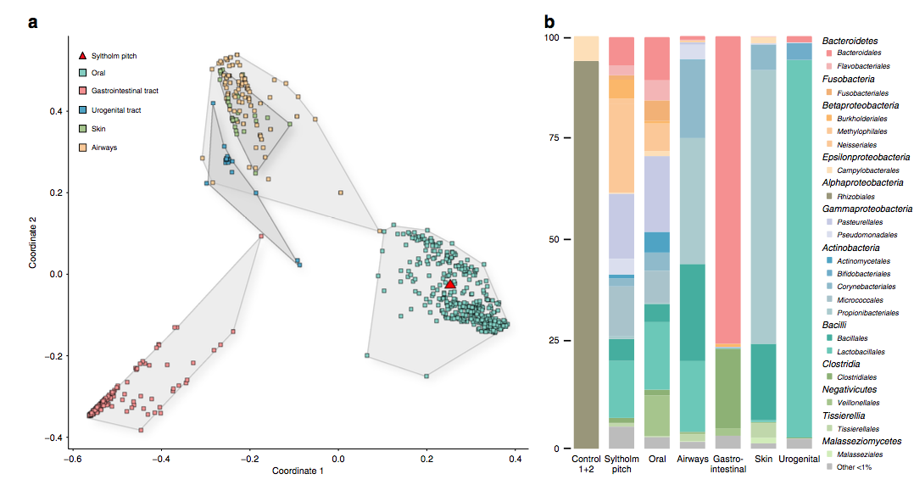
Ecological distances transformed using PCA (A), Phylum profiles in mastics (B)
Notes:
In this study researcher used shotgun sequencing method to obtain DNA sequences. The phylum composition showed a similar pattern to oral microbiome.
Moreover they used PCA analysis on the Bray-Curtis ecological distance matrix. The clustering pattern confirmed that the chewed mastic particle contain notable amounts of bacterial phyla.

Slide 15
They found some pathogens:
Streptococcus pneumoniaea
Epstein-Barr Virus
Red complex
Notes:
Moreover, they have found numerous human pathogens.
S. pneumonia is responsible community acquired pneumonia and for infant deaths. Some genes identified that are associated with colony and biofilm formation.
Blood borne viruses, Epstein Barr virus that is responsible for glandular fever. It is known that the most common human viruses infects over 90% of worlds population.
Red complex: responsible in periodontal diseases.

Slide 16
Links with disease
How a disease oriented microbiome cause diseases?
- Bacteraemia
Notes:
In those studies, I’ve tried to build a base for dysbiotic microbiome. But how dysbiotic microbiome affects pathogenesis?
For example, periodontitis is most common causes of bacteremia cases. The residing microbial community in oral microbiome could trigger diseases when they access blood stream.
Gemella sanguinis Haemophilus influenza
They cause infective endocarditis that is responsible for deaths
Take home message: Disease oriented microbiome could trigger diseases.

Slide 17
Pathogen genomics
Epidemics!
Plague
Notes:
What about pathogen genomics?
The most well known cases are epidemics.
Those epidemics were responsible of massive deaths in our history. Especially in Middle Ages.

Slide 18
Sample
DNA
Metagenomics
Microbial Diversity
Microbial Abundances
Pathogen Genomics
Notes:
The type of the historical material defines how we could move.
Add distances Pathogen genomics

Slide 19
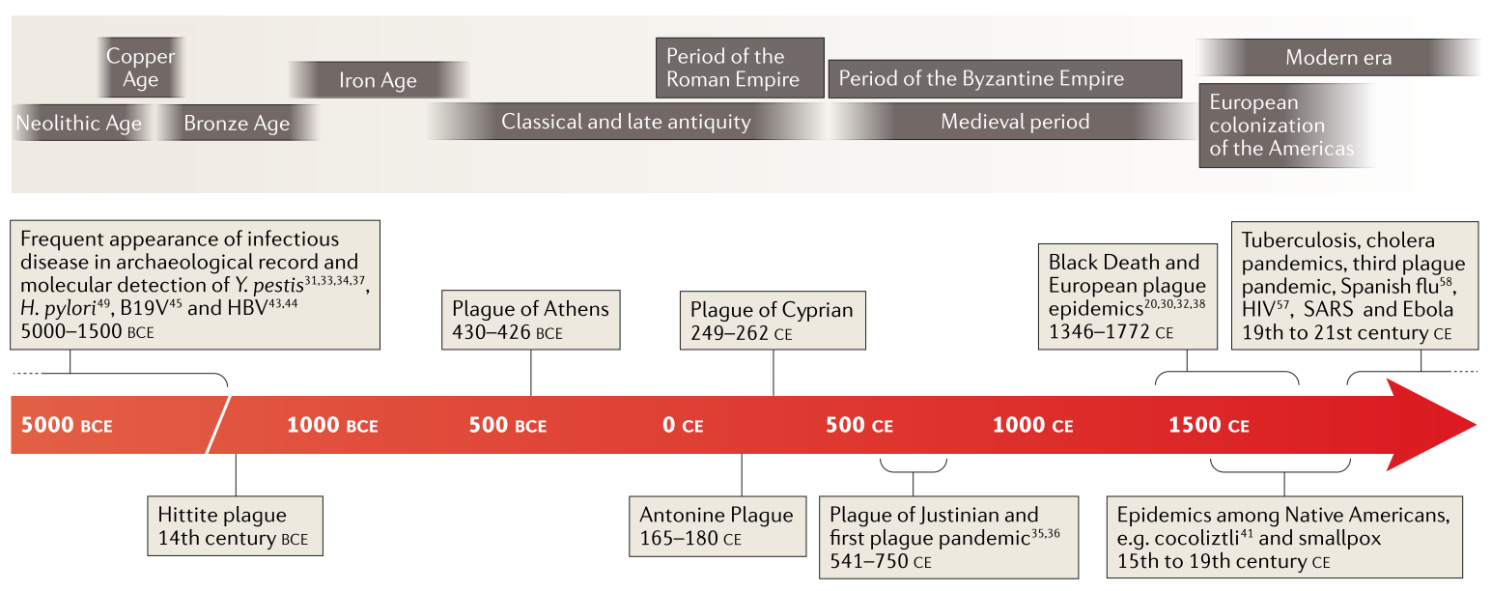
Epidemics
The epidemics history through ages (Spyrou et al., 2019)
Notes:
The first molecular records of epidemics: 5000 BCE
Y. pestis
Human Parvovirus (B19V)
HPV
H. pylori

Slide 20
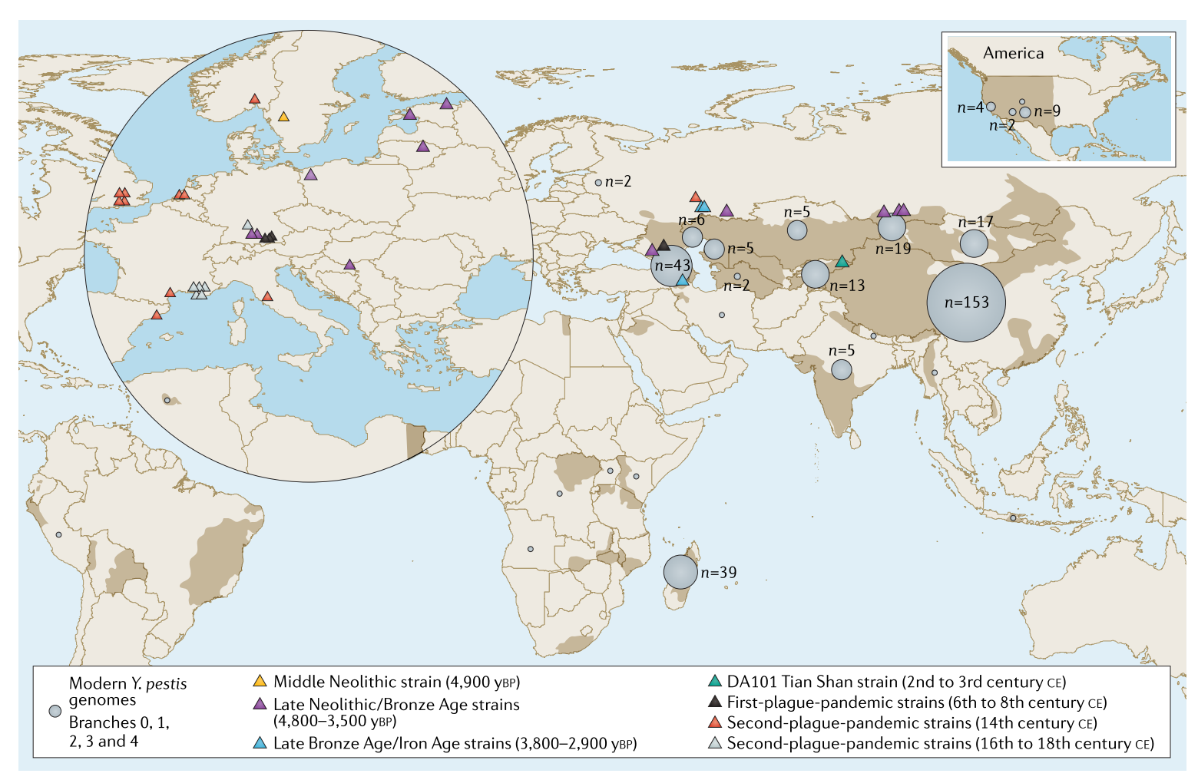
Notes:
17
Gram negative bacterium Yersinia pestis. It is the causative agent of the plague pandemics in Middle Ages.
It evolved from a close relative, Yersinia pseudotuberculosis, which is an environmental enteric disease causing bacterium.
Although the two species are clearly distinguishable via their virulence potential and transmission mechanisms
Nucleotide genomic identity reaches 97% among chromosomal protein coding genes.
Y. pestis are conferred by the unique acquisition of two plasmids:
pCP1, which contributes to the invasive potential of the bacterium
pMT1, which is involved in flea colonization,
chromosomal gene pseudogenization of biofilm genes
The transmission mechanism is through a flea vector. Yersinia murine toxin (ymt) gene, which is present on the pMT1 plasmid creates a barrier in flea midgut, preventing the food.

Slide 21
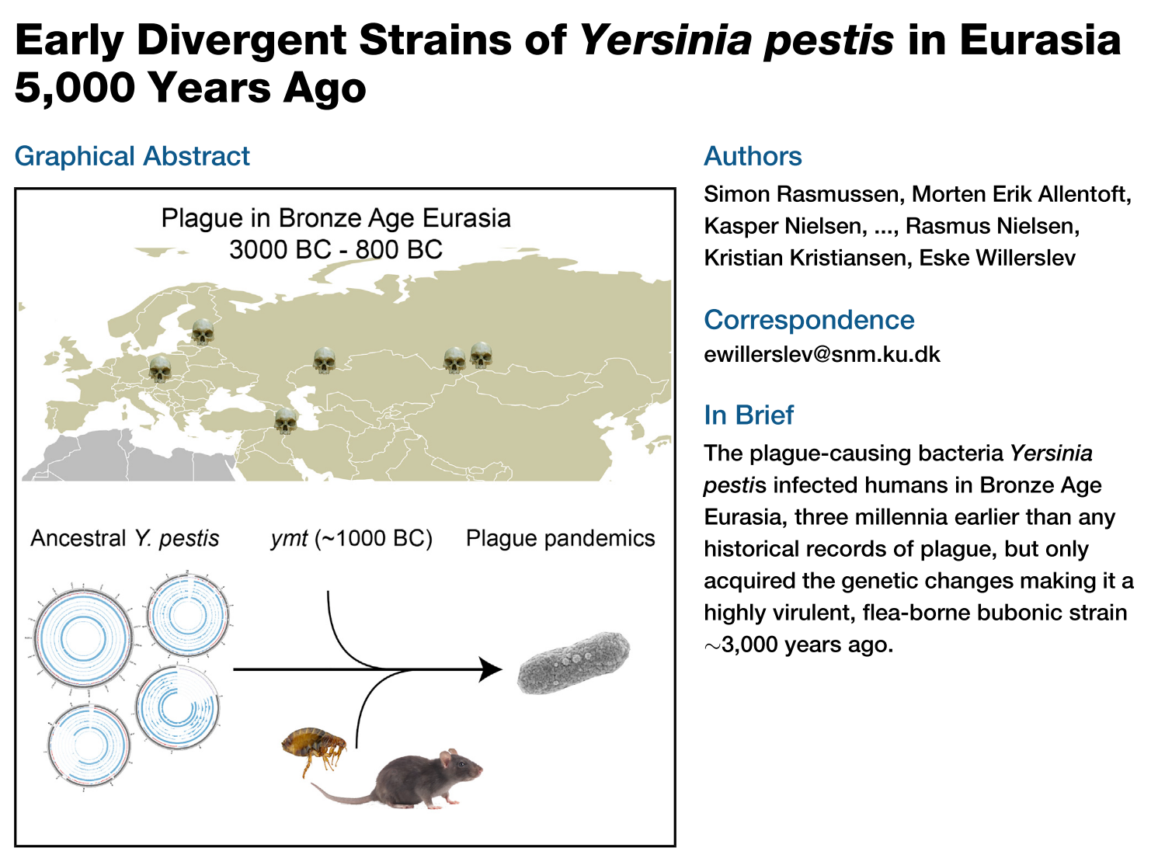
Notes:
This study suggests that the ymt gene acquisition in Y. pestis 1000 years before present.

Slide 22
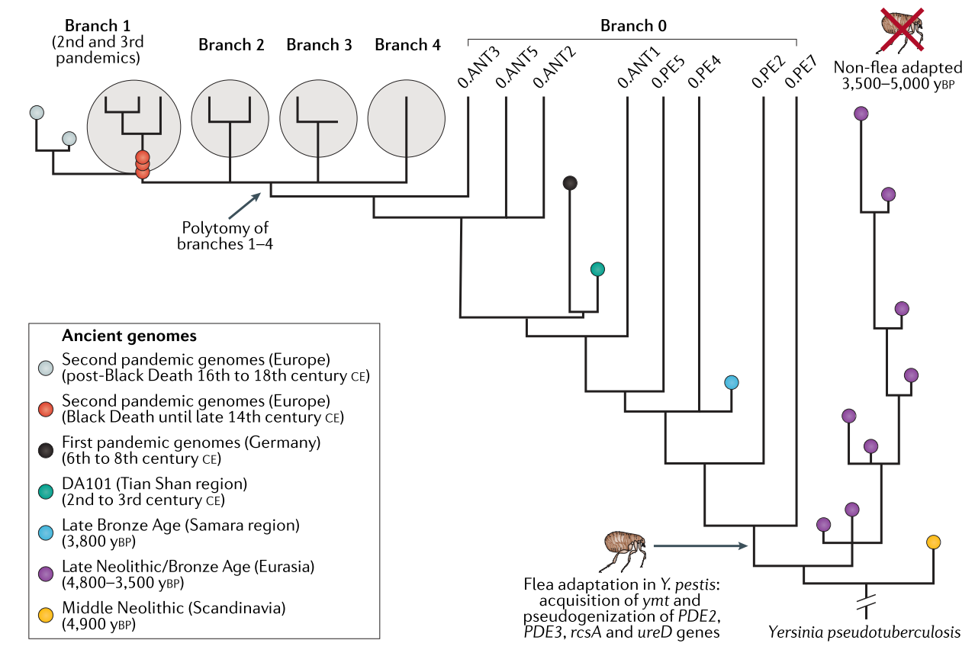
The phylogenetic analysis of plague (Spyrou et al., 2019)
Notes:
The divergence between pseudo tuberculosis and Y. pestis could be based on aDNA data 13,000–79,000 years before present.
Y. pestis identification in human remains from Neolithic and Bronze Age Eurasia suggests that it caused human infections during these periods and originated more than 5,000 years ago.
Late Neolithic and Bronze Age (LNBA) occupy a basal lineage in the Y. pestis. In early times, Y. Pestis genomes lack of virulence genes. It could be active but not as active as bubonic plague.
For bubonic plague, flea transmission should be needed.

Slide 23
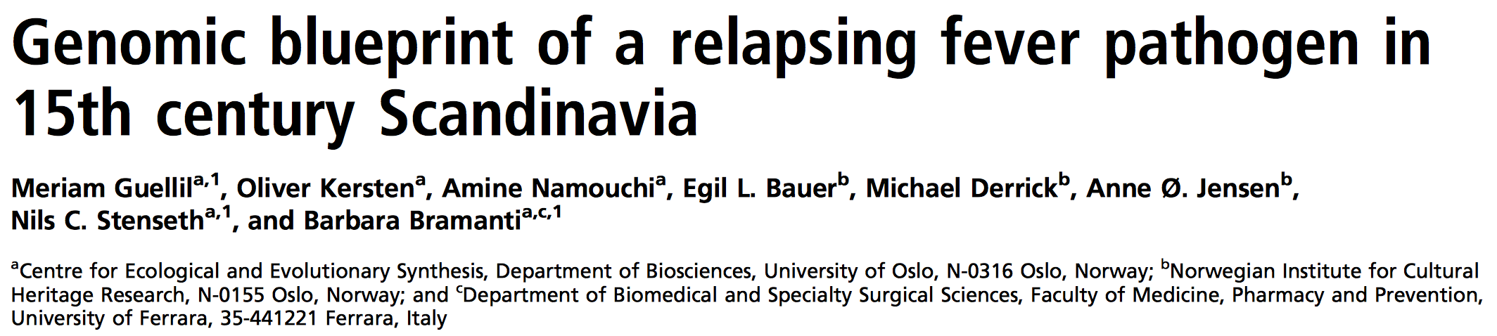
Notes:
20
Borrellia recurrentis
Louse-borne relapsing fever was one of the major diseases affecting Western human populations, with its last major pandemic killing millions after World War I
It is known to have killed millions of people over the course of European history and remains a major cause of mortality in parts of the world.
In this study researchers reconstructed 6.4× coverage B. recurrentis genome(95.2% of the genome at least 2x coverage).
They searched for specific surface lipoproteins.
For relapsing fever, some surface liporproteins should be translated to evade from the host immunity and prolong the infection.
In B. recurrentis, these proteins are the surface lipoproteins vlp and vsp, which are also known to be its main proinflammatory proteins. Research showed that the middle age strain does not have those lipoproteins.

Slide 24
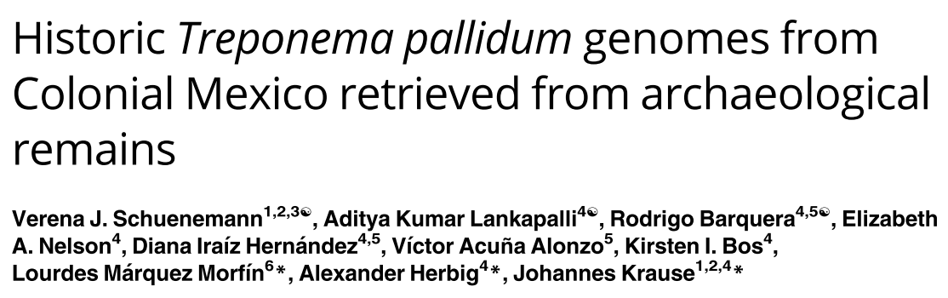
Notes:
Syphilis
Yaws
Treponema pallidum infections occur worldwide causing, among other diseases, syphilis and yaws. In particular sexually transmitted syphilis is regarded as a re-emerging infectious disease with millions of new infections annually.
3 historic T. pallidum genomes reconstructed between 17th and 19th century.

Slide 25
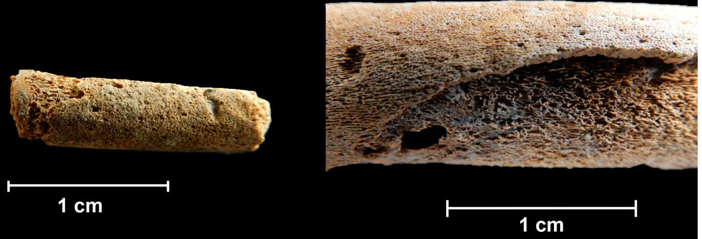
Skeletal materials with lesions
Notes:
22
Researchers used skeletal materials with lesions for shotgun sequencing method.
They have reconstructed three reference genomes with at least 3x coverage. However the could not distangle the complex evolution behind it.

Slide 26
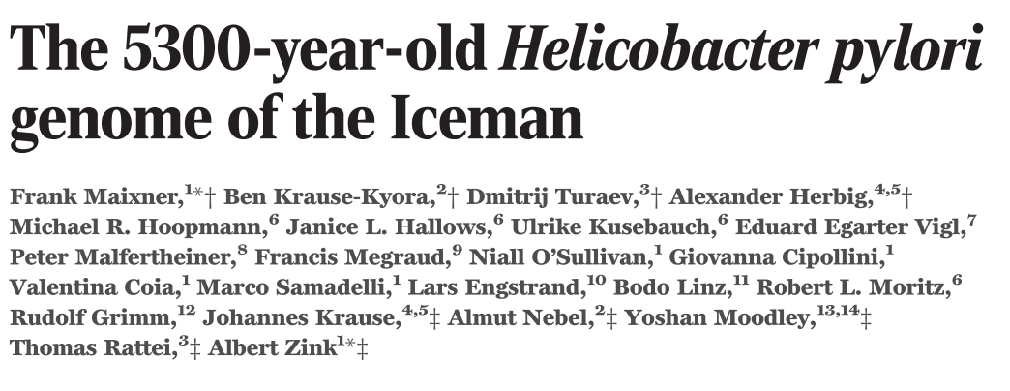
Notes:
23
Ötzi iceman. Good conservation stats. That makes a good candidate for ancient metagenomic studies.
Helicobacter pylori is one of the most prevalent human pathogens.
It has dispersed globally with its human host, resulting in a distinct phylogeographic pattern that can be used to reconstruct both recent and ancient human migrations.

Slide 27
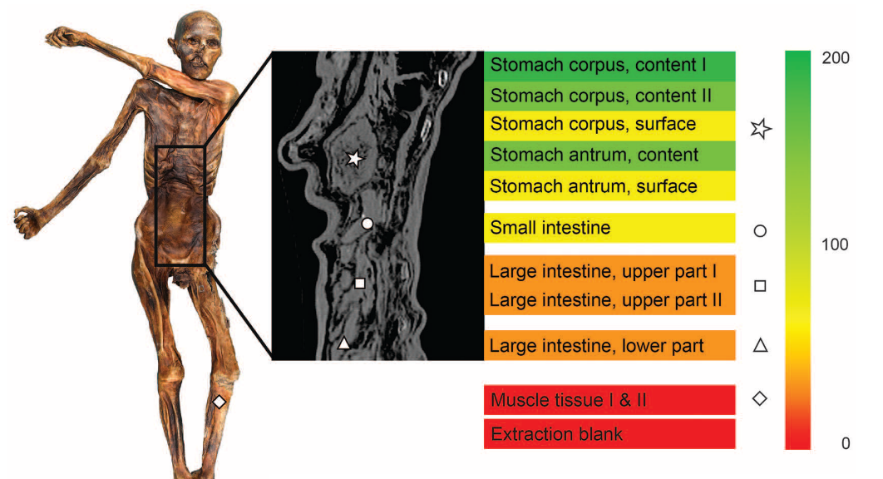
The sampling strategy of the gut microbiome of Öti
Notes:
24

Slide 28
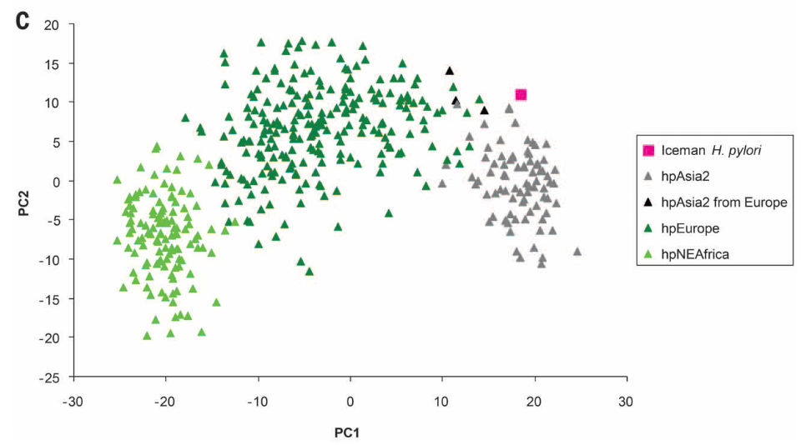
PCA analysis of Ötzi H. pylori and modern starins
Notes:
25
The extant European population of H. pylori is known to be a hybrid between Asian and African bacteria, but there exist different hypotheses about when and where the hybridization took place, reflecting the complex demographic history of Europeans. Here, we present a 5300-year-old H. pylori genome from a European Copper Age glacier mummy. The “Iceman” H. pylori is a nearly pure representative of the bacterial population of Asian origin that existed in Europe before hybridization, suggesting that the African population arrived in Europe within the

Slide 29
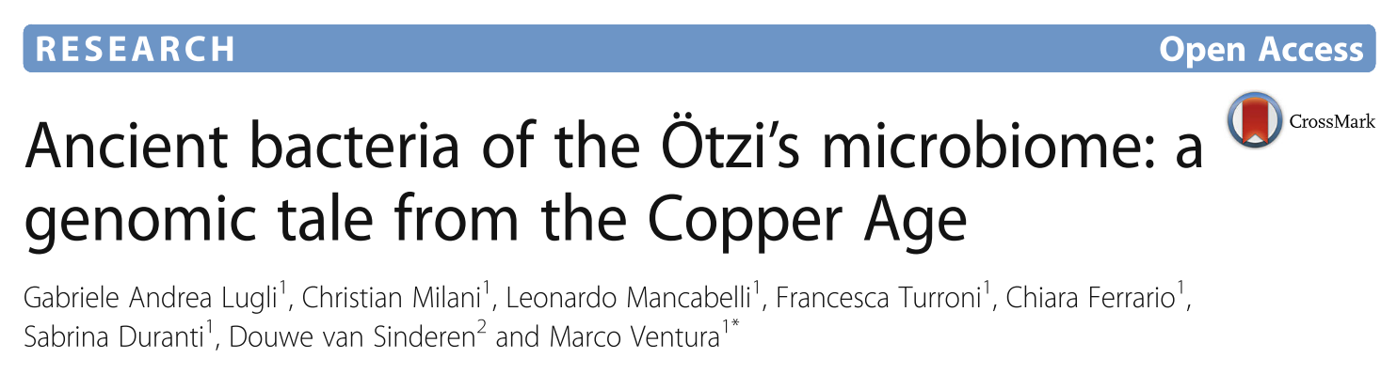
Notes:
27
In a follow-up study, researcher found even more. In this study, researchers tried to catalogue the distal gut microbiome.

Slide 30
Clostridium perfringes
Virulence genes have already existed in the ancient strain
Pseudomonas veronii
Recent acquirement of antibiotic resistance genes
Notes:
28

Slide 31
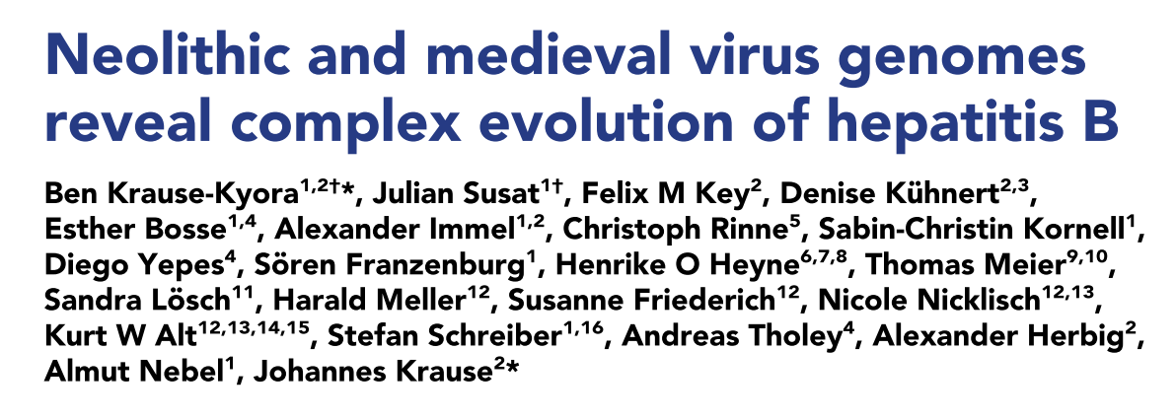
Notes:
29

Slide 32
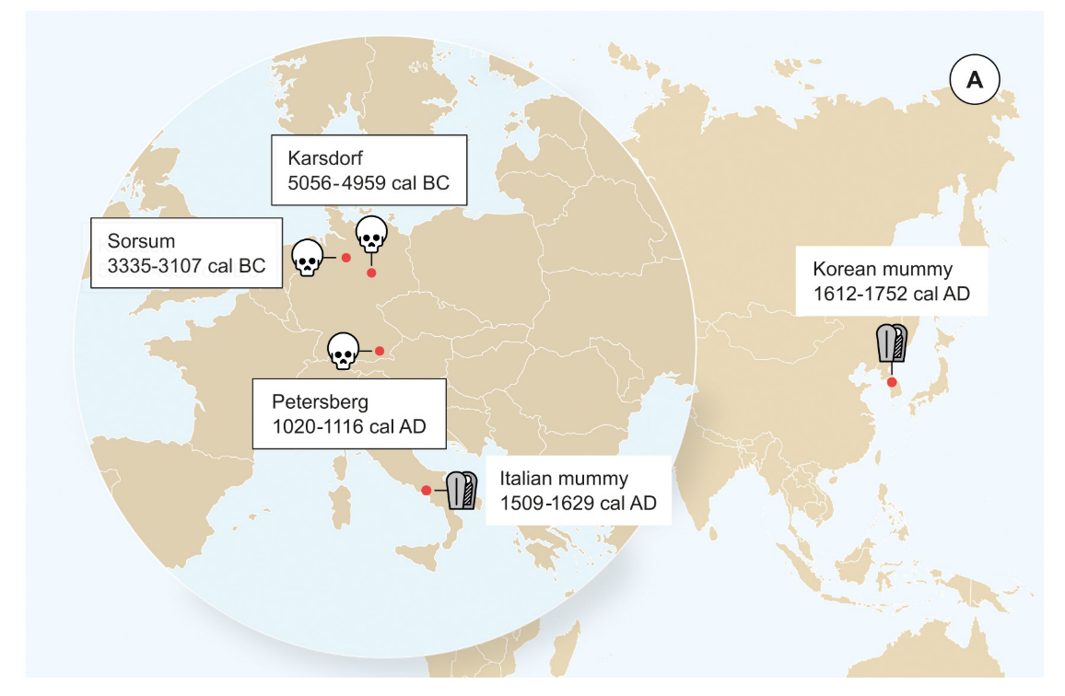
HBV
Geographic locations of the samples
Notes:
The hepatitis B virus (HBV) is one of the most widespread human pathogens known today, yet its origin and evolutionary history are still unclear and controversial. Here, we report the analysis of three ancient HBV genomes recovered from human skeletons found at three different archaeological sites in Germany. We reconstructed two Neolithic and one medieval HBV genome by de novo assembly from shotgun DNA sequencing data.

Slide 33
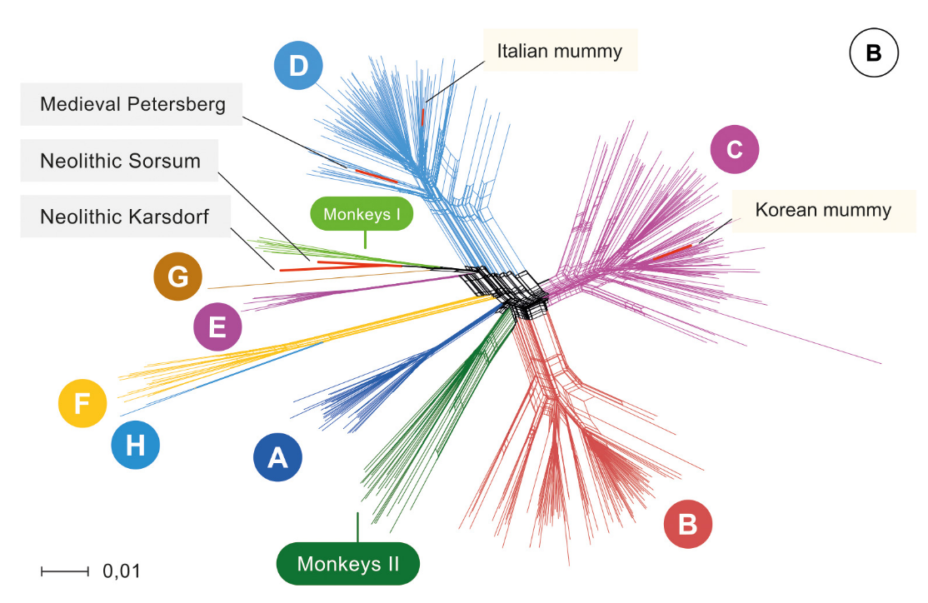
HBV
The phylogenetic network of the HBv with current strains
Notes:
31
Results showed that the ancient lineages extinct
Results suggests that has circulated in the European population for at least 7000 years.
The Neolithic HBV genomes show a high genomic similarity to each other. In a phylogenetic network, they do not group with any human-associated HBV genome and are most closely related to those infecting African non-human primates. The ancient viruses appear to represent distinct lineages that have no close relatives today and possibly went extinct. Our results reveal the great potential of ancient DNA from human skeletons in order to study the long-time evolution of blood borne viruses.

Slide 34
Conclusion
Ancestral state on human microbiome
Adaptation of our microbiome
Pathogen evolution
Notes:
32
References and additional readings:
Petersen, C., & Round, J. L. (2014, July). “Defining dysbiosis and its influence on host immunity and disease.” Cellular Microbiology. Wiley-Blackwell. http://doi.org/10.1111/cmi.12308
Lloyd-Price, J., Abu-Ali, G., & Huttenhower, C. (2016). “The healthy human microbiome.” Genome Medicine. http://doi.org/10.1186/s13073-016-0307-y
Maixner, F., Krause-Kyora, B., Turaev, D., Herbig, A., Hoopmann, M. R., Hallows, J. L., … Zink, A. (2016). “The 5300-year-old Helicobacter pylori genome of the Iceman.” Science, 351 (6269), 162–165. http://doi.org/10.1126/science.aad2545

